Slide 1
CS263 Final Project Andre Abreu Calfa Strategy Board
UCSB Fall 2014

Slide 2
MOTIVATION
Tool to assist organized online gaming tournaments.
What is an organized tournament?
Community of volunteers, donators, developers and gamers.
Played on many different PC game series (Project focuses on Battlefield PC game).
BFE-WAW (Battle For Europe – World at War) USA, since 2003, 30 campaigns.
21CW (21st Century Warfare) USA, Since 2003, 49 campaigns, +11,000 users.
F|H (Forgotten Honor) Europe, Since 2004, +20,000 users.
BpM (Batalha pelo Mundo, Battle for the World in Portuguese) Brazil, since 2004, +8,000 users.

Slide 3
MOTIVATION
Key aspects in an organized tournament:
Building a winning strategy.
Communication: Foruns and Teamspeak.
Teamspeak: VoIP client-server, last version rewritten in C++.
Teamwork
Project goal: helpful “on the fly” strategy tool
Less overhead in communication.
Quicker strategy adaptations.

Slide 4
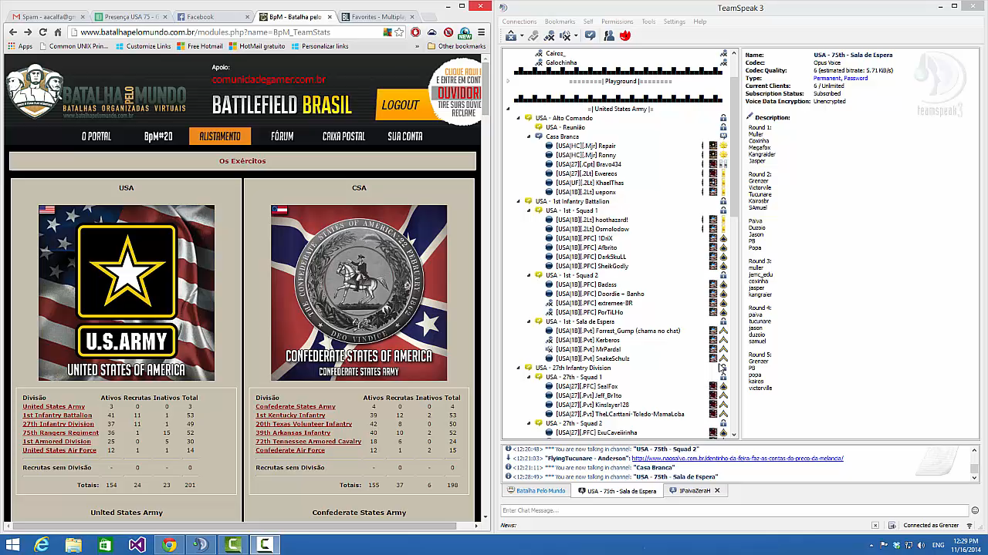
MOTIVATION

Slide 5
PROJECT OVERVIEW
Java Google App Engine (GAE) Application
APIs used:
Datastore – User and app internal data.
Blobstore – Store game maps images.
Taskqueue – Feedback emailing.
Images – Show maps and markers.
Open to Google Accounts users.
JAX-RS + JSON – for feedback emails and marker manipulation.
Use of GSON to facilitate send/receive JSON data .
Maven build automation.
Github repo: https://github.com/aacalfa/CS263aacalfaproject
Fully documented in Javadocs.
Notes:
Open to Google Accounts users: anyone with a valid gmail account can login to the app

Slide 6
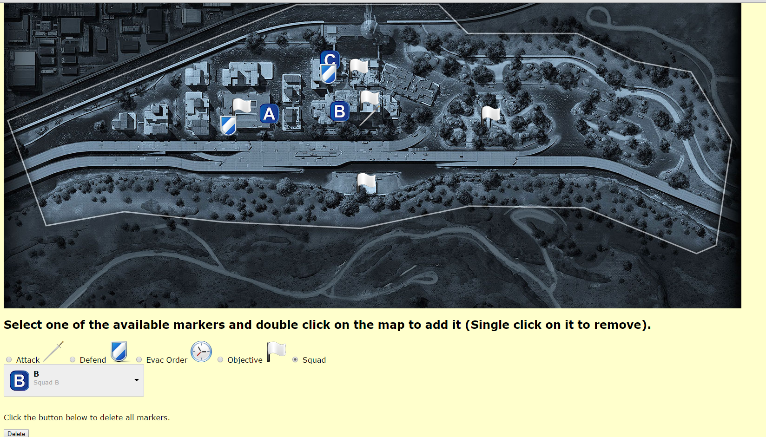

Slide 7
Datastore
Three main entities:
GameMap: Map image blobkeys and their names.
MapAttributes: Map marker blobkeys and their names
UserData: User gmail account and every marker added by that user.
Example: AMIfv9&AMIfv95z&728&454 (GameMap blobkey + Map marker blobkey + X coordinate + Y coordinate

Slide 8
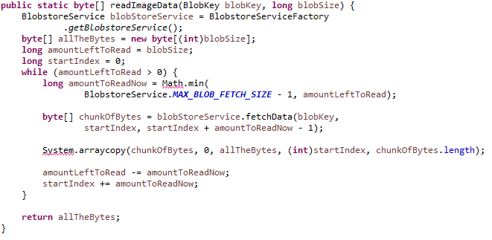
Blobstore
Upload and serve map image and attributes (markers).
Image file format MUST allow transparency (Cannot be JPEG). PNG tested.
Fetching blobs greater than 1MB:

Slide 9
Memcache
Initial idea:
Writing and reading markers to and from DataStore: overhead.
Attempt: Use Memcache API to fetch markers instantaneously.
Problem: Cannot query Memcache, how to know what keys to fetch?
Only way would be to store keys in DataStore, but obviously requires an unintended query to the DataStore.
Alternative: Store all game map info (Map file name, map file size, map image dimensions and image format) in Memcache, avoiding loading those info everytime, show them in main menu.

Slide 10
TaskQueue
Users can email the developer to send suggestions, report bugs, etc.
Push queue processes emails on a rate of 5 tasks per second.
Due to authentication limitations, an email is sent from my email account to itself, but the body of the contains the email of whoever sent the feedback.

Slide 11
Images API
Load map image bytes and display it.
Markers are added to the map as in a transparent overlay. Double-click on desired position
Uses the “Composite” feature in Images API.
Markers are removed individually by clicking once on them.
All markers can be removed simultaneously by clicking “delete” button.
Notes:
The map image and each marker are added to the composite list. Access datastore to get the correct markers.

Slide 12
NOVELTY
One of the first attempts to improve team performance during the heat of match.
Provides support to large gaming communities.
Can be used in different games and tournament styles.
Notes:
Obs1: One of the first attempts to improve team performance during the heat of match. -> in previous games where editing in-game features was feasible, the map itself could be replaced with a layered map containing useful data for strategy.
The current games generally do not allow any modification to their playability - PUNKBUSTER

Slide 13
EXPERIENCE
My first web application.
Google App Engine serves as an easy platform to start building web apps but…
It has limitations:
Java libraries for drawing (awt) are not compatible with GAE.
Devappserver bug discards image transparency.
Fetching data from blobstore gets complicated when blob size is greater than 1MB.

Slide 14
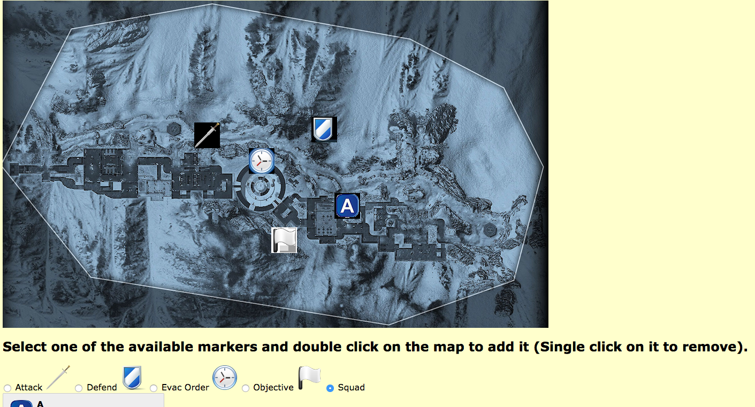

Slide 15
PERFORMANCE EVALUATION
Primary idea: memcache for markers.
Problem: complexity to store and retrieve them.
Current add / delete marker slower but acceptable.
Stable application.
Improve click to delete tolerance.

Slide 16
APP DEMO
App can be accessed at: http://www.cs263aacalfaproject.appspot.com

